Slide 1
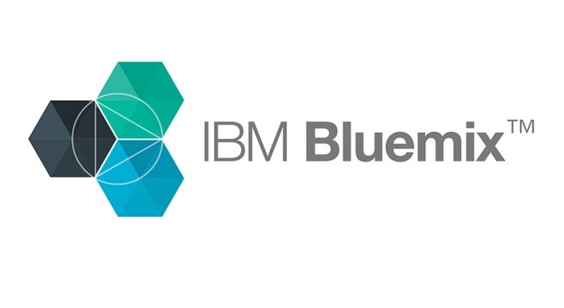
Nikhil Chinthapallee
Vamsi Vikash Ankam
Rishi Vardhineni
Kaustubh Sant

Slide 2
What is IBM Bluemix?
Bluemix offers “Platform as a Service” (Paas)
Supports multiple programming languages
Provides various services for application development and operations
Easy to deploy and manage hybrid applications
Perform big-data analytics and cognitive analysis using Watson Services

Slide 3
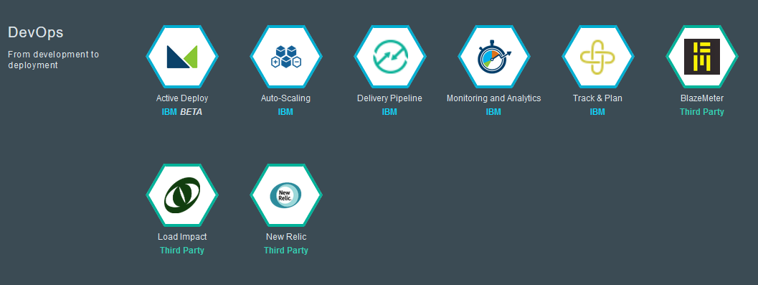
Devops Services Offered

Slide 4
Advantages of IBM Bluemix
Collaborative environment on Cloud.
Easy Deployment.
Rich Catalog of Reusable Services.
Source Control which provides Team collaboration.
Disadvantages of IBM Bluemix
VM instance creation takes a longer time
Lacks user friendliness
It isn’t free.

Slide 5
How does it work?
Simple steps
Create a new project
Choose your repository
Start coding - Edit code using Cloud Foundry or Live Edit
Track and Plan the project
Build and Deploy the project

Slide 6
DEMO

Slide 7
Q & A
THANK YOU

